Slide 1
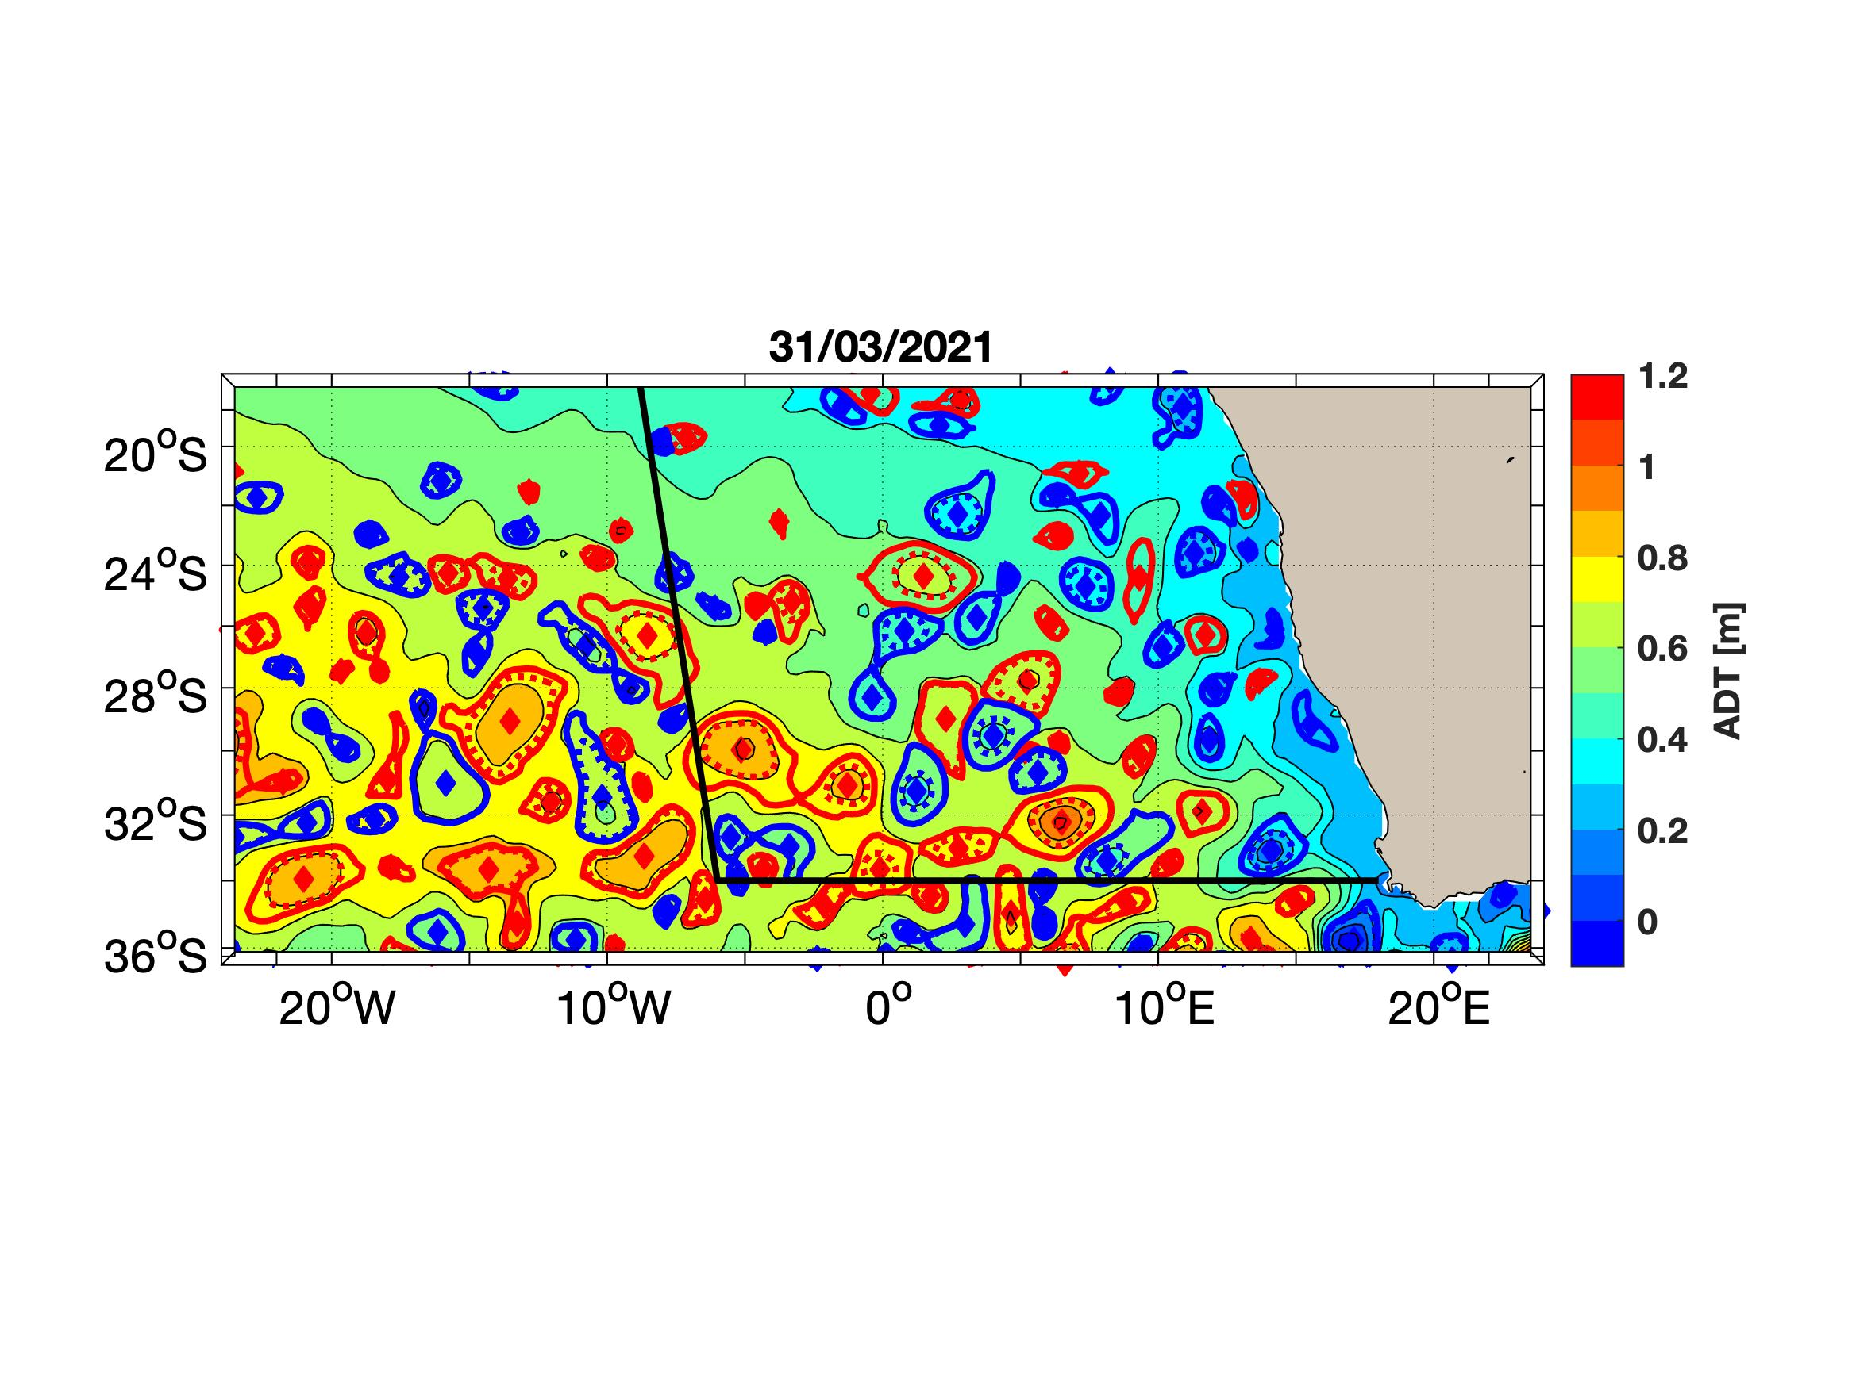
Potential Anticyclones
1. Surface AR
Red : Anticyclones
Blue : Cyclones
Black : Expected Track of the cruise
AC2: Priority 4
AC1: Priority 3
C2: Priority 2
C1: Priority 1

Slide 2
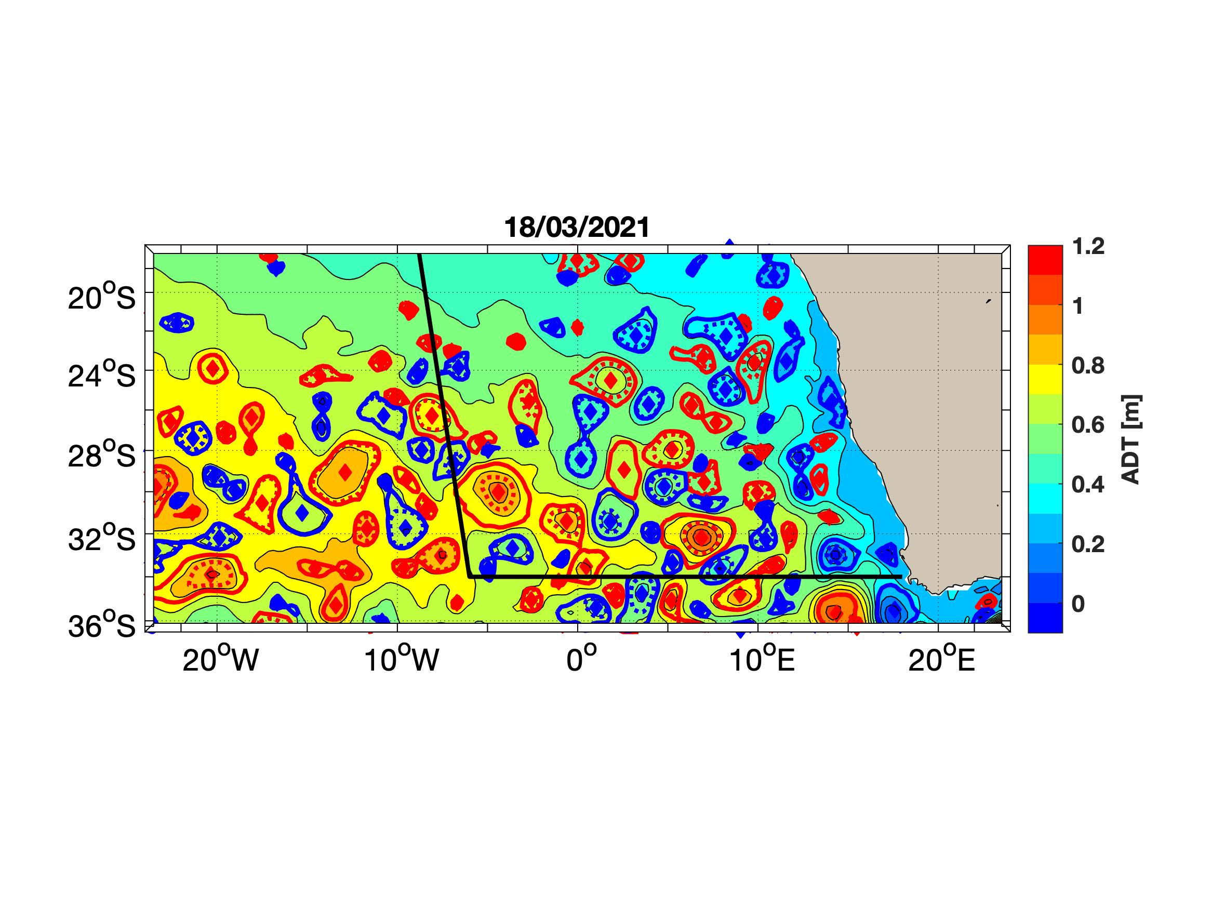
Snapshot ADT last 2 weeks
1. Surface AR
Red : Anticyclones
Blue : Cyclones
Black : Expected Track of the cruise

Slide 3
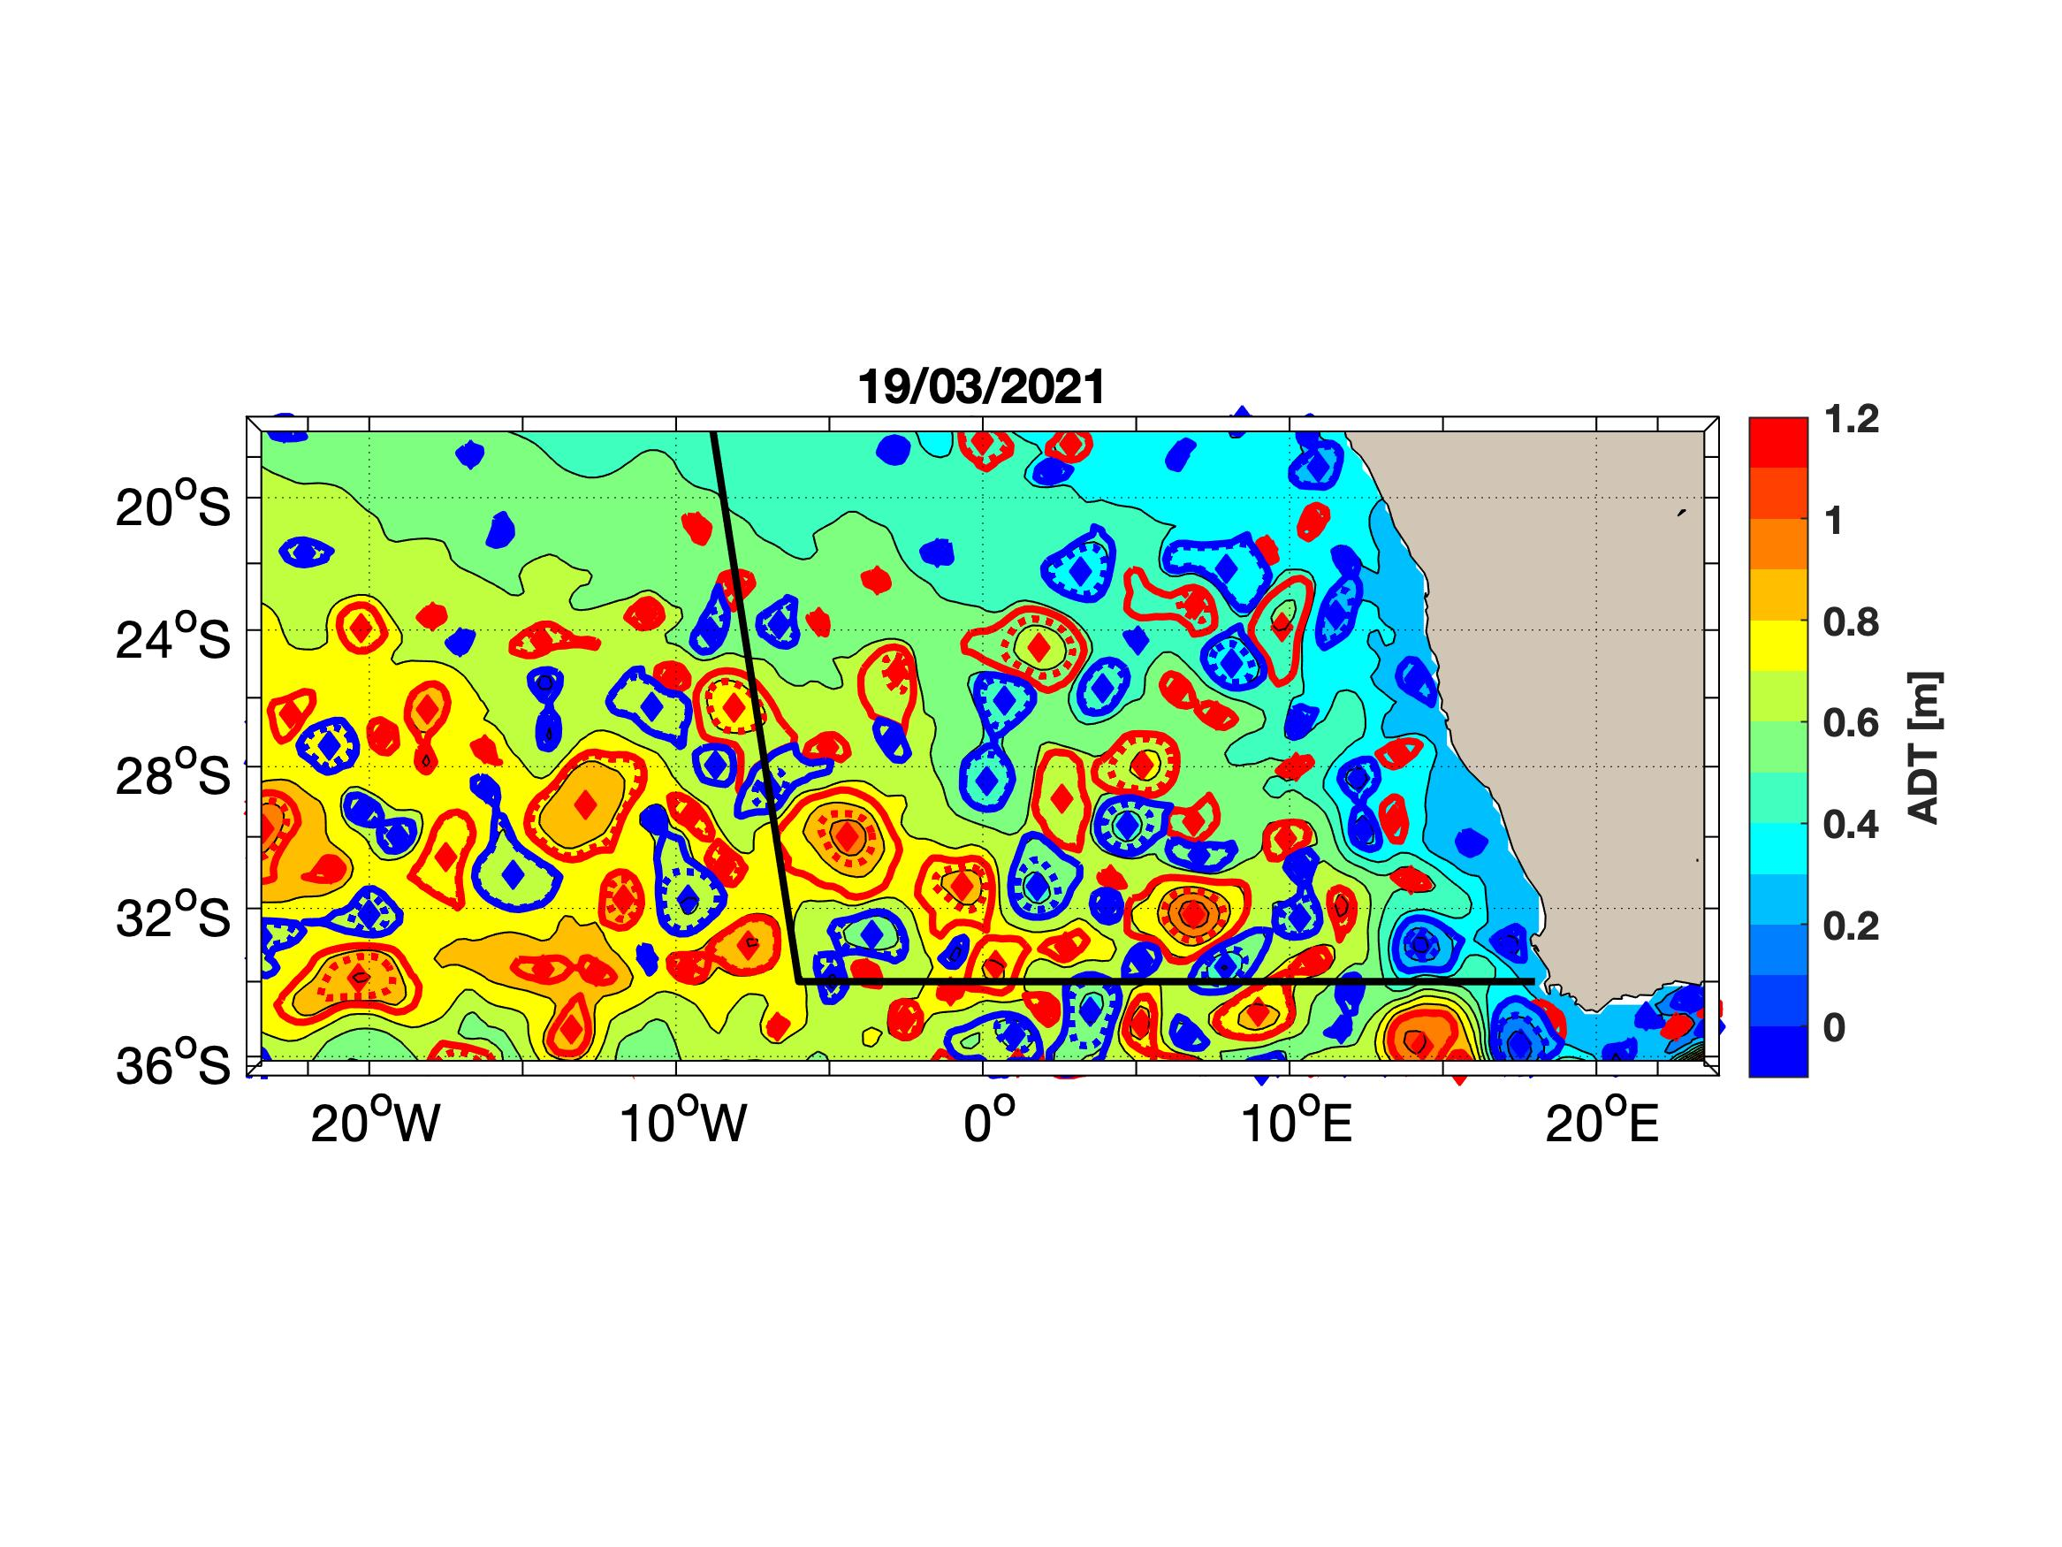
Snapshot ADT last 2 weeks
1. Surface AR
Red : Anticyclones
Blue : Cyclones
Black : Expected Track of the cruise

Slide 4

Snapshot ADT last 2 weeks
1. Surface AR
Red : Anticyclones
Blue : Cyclones
Black : Expected Track of the cruise

Slide 5
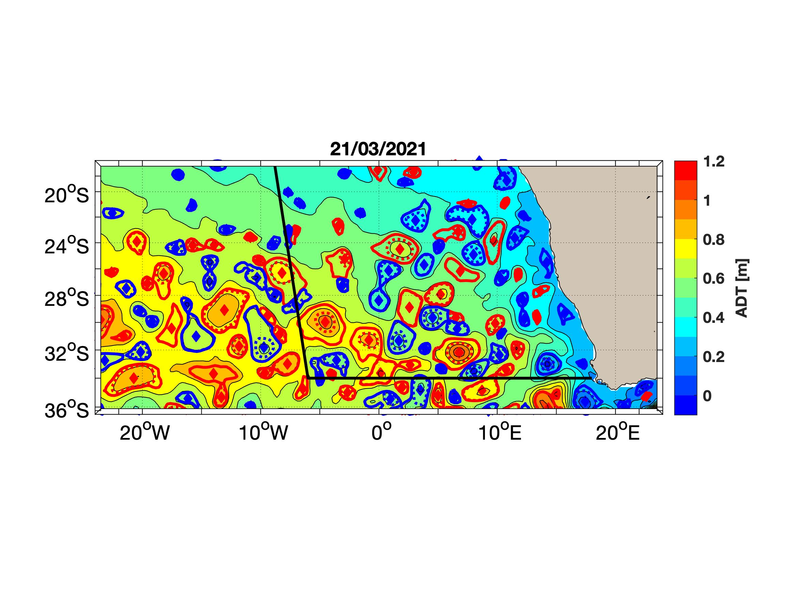
Snapshot ADT last 2 weeks
1. Surface AR
Red : Anticyclones
Blue : Cyclones
Black : Expected Track of the cruise

Slide 6

Snapshot ADT last 2 weeks
1. Surface AR
Red : Anticyclones
Blue : Cyclones
Black : Expected Track of the cruise

Slide 7

Snapshot ADT last 2 weeks
1. Surface AR
Red : Anticyclones
Blue : Cyclones
Black : Expected Track of the cruise

Slide 8
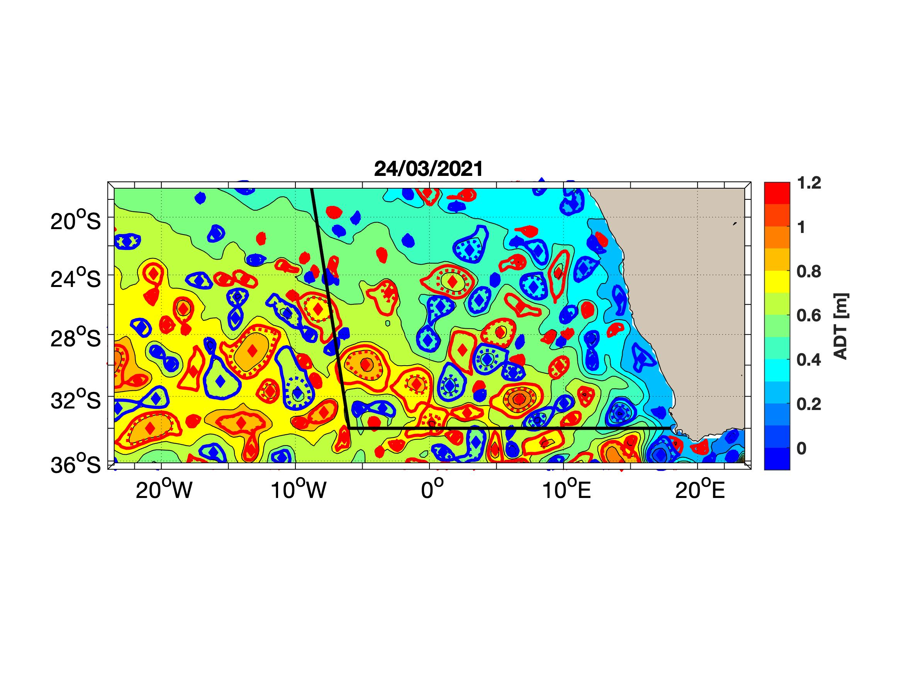
Snapshot ADT last 2 weeks
1. Surface AR
Red : Anticyclones
Blue : Cyclones
Black : Expected Track of the cruise

Slide 9

Snapshot ADT last 2 weeks
1. Surface AR
Red : Anticyclones
Blue : Cyclones
Black : Expected Track of the cruise

Slide 10

Snapshot ADT last 2 weeks
1. Surface AR
Red : Anticyclones
Blue : Cyclones
Black : Expected Track of the cruise

Slide 11

Snapshot ADT last 2 weeks
1. Surface AR
Red : Anticyclones
Blue : Cyclones
Black : Expected Track of the cruise

Slide 12

Snapshot ADT last 2 weeks
1. Surface AR
Red : Anticyclones
Blue : Cyclones
Black : Expected Track of the cruise

Slide 13

Snapshot ADT last 2 weeks
1. Surface AR
Red : Anticyclones
Blue : Cyclones
Black : Expected Track of the cruise

Slide 14

Snapshot ADT last 2 weeks
1. Surface AR
Red : Anticyclones
Blue : Cyclones
Black : Expected Track of the cruise

Slide 15
Snapshot ADT last 2 weeks
1. Surface AR
Red : Anticyclones
Blue : Cyclones
Black : Expected Track of the cruise

Slide 16
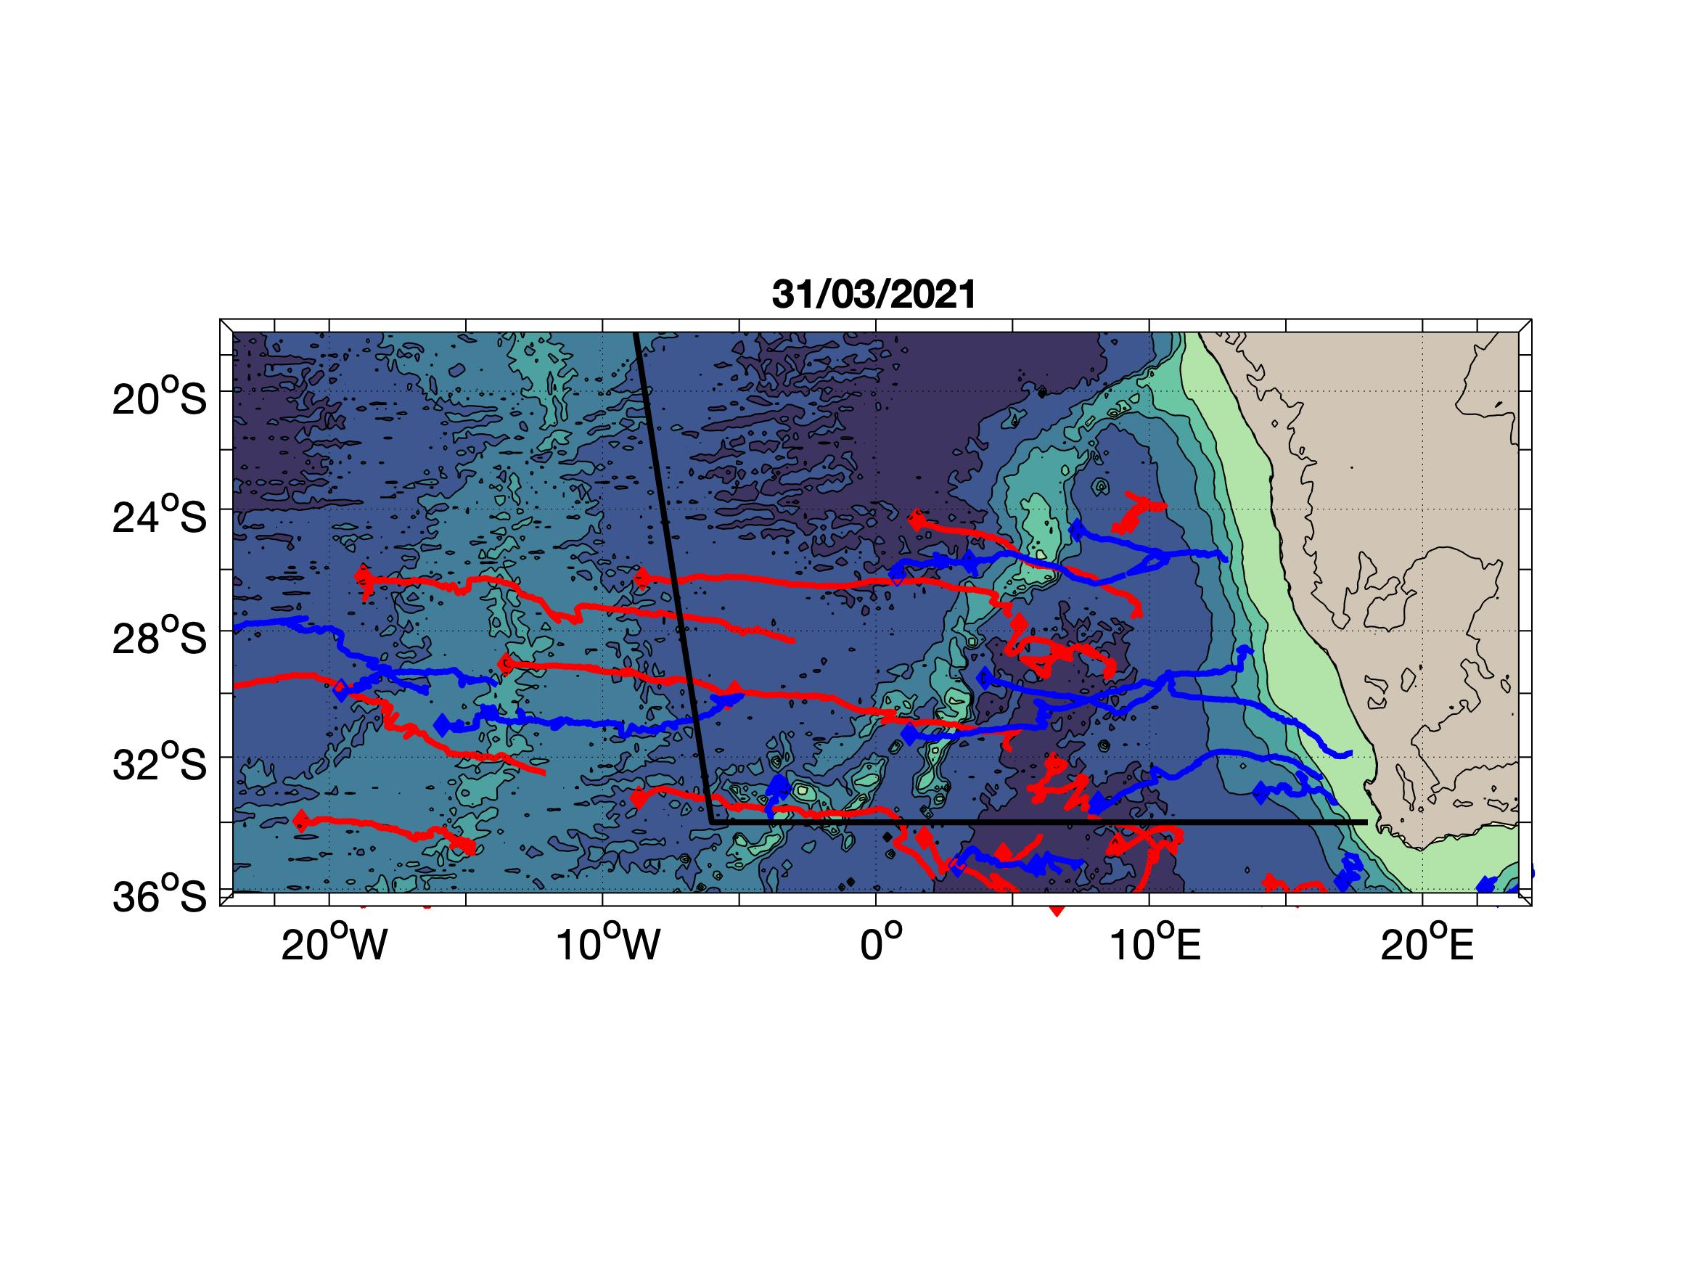
Trajectories still active (Amplitude > 5cm)
1. Surface AR
Red : Anticyclones
Blue : Cyclones
Black : Expected Track of the cruise
Background : Bathymetry

